Slide 1
Ensemble Learning

Slide 2
Ensemble Learning
Ensemble Learning is a machine learning technique where multiple models (often referred to as "learners") are combined to improve the overall performance of a predictive system.
The idea is that a group of models can often make better predictions than a single model by leveraging the strengths and compensating for the weaknesses of individual models.

Slide 3
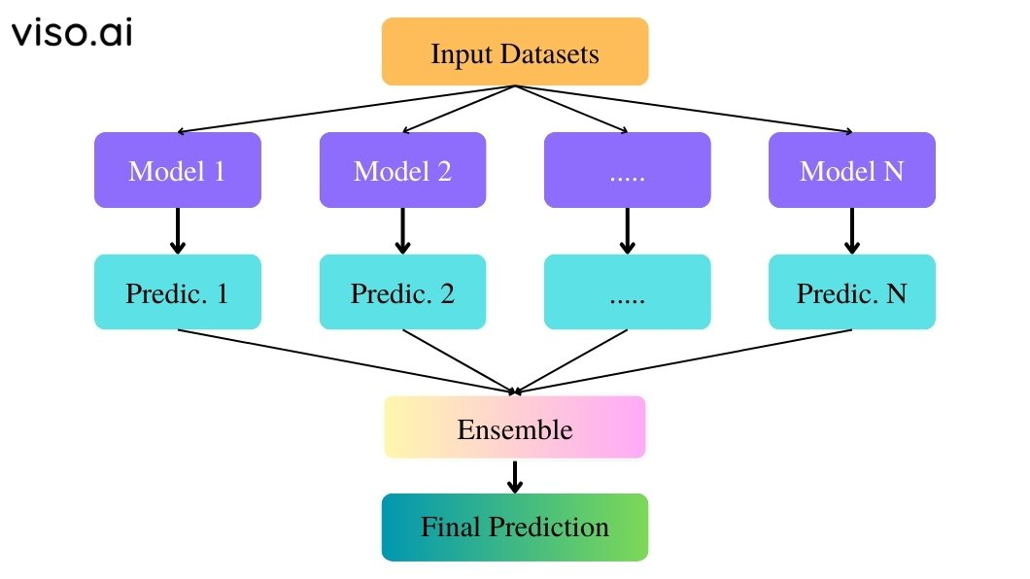
Ensemble Learning

Slide 4
Types of Ensemble Methods:
Bagging (Bootstrap Aggregating): Combines predictions from multiple models trained on different subsets of the training data. Example: Random Forest.
Boosting: Sequentially builds models where each new model focuses on correcting errors made by previous models. Examples: AdaBoost, Gradient Boosting.
Stacking: Combines predictions from multiple models using another model (meta-learner) to make the final prediction.

Slide 5
XGBoost, AdaBoost, and Gradient Boosting Overview
XGBoost (Extreme Gradient Boosting):
Concept: An optimized implementation of gradient boosting that includes regularization, handling missing values, and parallel processing.
Real-Time Example: Predicting customer churn based on features such as age, purchase history, and customer service interactions.

Slide 6
AdaBoost (Adaptive Boosting):
Concept: Boosting method that combines weak classifiers (e.g., simple decision trees) to create a strong classifier by focusing on the errors of previous classifiers.
Real-Time Example: Image recognition where initial models detect simple features like edges, and subsequent models correct errors and refine detections.

Slide 7
Gradient Boosting:
Concept: Sequential boosting method that builds models to correct errors made by previous models, usually using decision trees.
Real-Time Example: Predicting sales based on historical data where each new model tries to correct errors made by the previous models.

